Slide 1
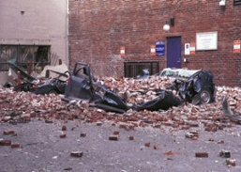
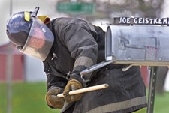
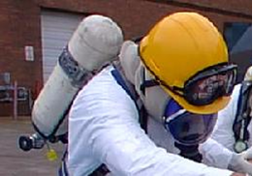
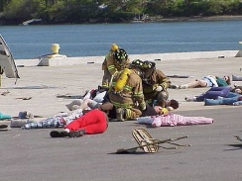
Disaster Site Worker Safety
Hazard Recognition & Assessment

Slide 2
Hazard/Risk Analysis
Hazard recognition
Hazard:
A condition, set of circumstances, or inherent property that can cause injury, illness, or death. Exposure: Contact with or proximity to a hazard, taking into account duration and intensity.
Risk:
An estimate of the combination of the likelihood of an occurrence of a hazardous event or exposure(s), and the severity of injury or illness that may be caused by the event or exposures
Safety:
Defined as a judgment of the acceptability of risk
Notes:
ANSI Z10
Hazard: A condition, set of circumstances, or inherent property that can cause injury, illness, or death.
Exposure: Contact with or proximity to a hazard, taking into account duration and intensity.
Risk: An estimate of the combination of the likelihood of an occurrence of a hazardous event or exposure(s), and the
severity of injury or illness that may be caused by the event or exposures (See Appendix E).
Probability: The likelihood of a hazard causing an incident or exposure that could result in harm or damage—for a
selected unit of time, events, population, items or activity being considered.
Severity: The extent of harm or damage that could result from a hazard-related incident or exposures.
Risk assessment: Process(es) used to evaluate the level of risk associated with hazards and system issues.

Slide 3
Hazard analysis
Assure Management commitment, involvement, and direction.
Select a risk assessment team, including employees with knowledge of jobs and tasks.
Establish analysis parameters.
Select risk assessment technique.
Identify hazards.
Notes:
A general guide on how to make a hazard analysis and how to extend the process into a risk assessment.
Whatever the simplicity or complexity of the hazard/risk situation, and whatever the choice of the risk assessment
method, the following process is recommended.
• Assure Management commitment, involvement and direction (an absolute).
• Select a risk assessment team, including employees with knowledge of jobs and tasks.
• Establish the analysis parameters.
• Select a risk assessment technique.
• Identify the hazards.
• Consider failure modes.
• Assess the severity of consequences.
• Determine occurrence probability, prominently taking into consideration the exposures.
• Define the initial risk.
• Make risk acceptance or non-acceptance decisions with employee involvement.
If needed, select and implement hazard avoidance, elimination, reduction and control measures.
• Address the residual risk.
• Make risk acceptance or non-acceptance decisions with employee involvement.
• Document the results.
• Follow-up on the actions taken.

Slide 4
Hazard analysis
Consider failure modes.
Assess severity of consequences.
Determine occurrence probability, prominently taking into consideration the exposures.
Define the initial risk.
Make risk acceptance or non-acceptance decisions with employee involvement.
Address residual risk.
Make risk acceptance or non-acceptance decisions with employee involvement.
Notes:
A general guide on how to make a hazard analysis and how to extend the process into a risk assessment.
Whatever the simplicity or complexity of the hazard/risk situation, and whatever the choice of the risk assessment
method, the following process is recommended.
• Assure Management commitment, involvement and direction (an absolute).
• Select a risk assessment team, including employees with knowledge of jobs and tasks.
• Establish the analysis parameters.
• Select a risk assessment technique.
• Identify the hazards.
• Consider failure modes.
• Assess the severity of consequences.
• Determine occurrence probability, prominently taking into consideration the exposures.
• Define the initial risk.
• Make risk acceptance or non-acceptance decisions with employee involvement.
If needed, select and implement hazard avoidance, elimination, reduction and control measures.
• Address the residual risk.
• Make risk acceptance or non-acceptance decisions with employee involvement.
• Document the results.
• Follow-up on the actions taken.

Slide 5
Hazard analysis
If needed, select and implement hazard avoidance, elimination, reduction and control measures.
Address residual risk.
Make risk acceptance or non-acceptance decisions with employee involvement.
Document results.
Follow-up on actions taken.
Notes:
A general guide on how to make a hazard analysis and how to extend the process into a risk assessment.
Whatever the simplicity or complexity of the hazard/risk situation, and whatever the choice of the risk assessment
method, the following process is recommended.
• Assure Management commitment, involvement and direction (an absolute).
• Select a risk assessment team, including employees with knowledge of jobs and tasks.
• Establish the analysis parameters.
• Select a risk assessment technique.
• Identify the hazards.
• Consider failure modes.
• Assess the severity of consequences.
• Determine occurrence probability, prominently taking into consideration the exposures.
• Define the initial risk.
• Make risk acceptance or non-acceptance decisions with employee involvement.
If needed, select and implement hazard avoidance, elimination, reduction and control measures.
• Address the residual risk.
• Make risk acceptance or non-acceptance decisions with employee involvement.
• Document the results.
• Follow-up on the actions taken.

Slide 6
Overall Risk
Overall risk depends upon:
Likelihood that a disaster event will occur or a terrorist will make an attempt to target a critical asset:
People
Property
Probability event or attempt will be successful
Value of the assets lost
Notes:
ANSI Z10
Risk: An estimate of the combination of the likelihood of an occurrence of a hazardous event or exposure(s), and the
severity of injury or illness that may be caused by the event or exposures

Slide 7
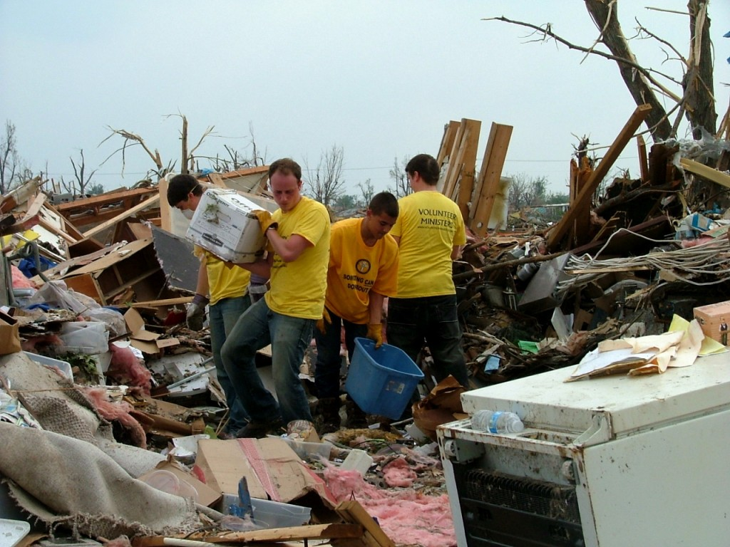
Hazard recognition
HAZARD RECOGNITION
SLIPS – TRIPS – FALLS
PUNCTURE WOUNDS
FALLING OBJECTS
FLYING DEBRIS
ELECTRICAL
GAS (NATURAL/PROPANE)
LACERATIONS
STRAINS & SPRAINS
HEAT STRESS
INHALATION
HAZARD RECOGNITION

Slide 8
Hazard assessment
HAZARD RECOGNITION | PROBABILITY
SLIPS – TRIPS – FALLS
PUNCTURE WOUNDS
FALLING OBJECTS
FLYING DEBRIS
ELECTRICAL
GAS (NATURAL/PROPANE)
LACERATIONS
STRAINS & SPRAINS
HEAT STRESS
INHALATION
HAZARD RECOGNITION | PROBABILITY
SLIPS – TRIPS – FALLS | FREQUENT
PUNCTURE WOUNDS | FREQUENT
FALLING OBJECTS | OCCASIONAL
FLYING DEBRIS | REMOTE
ELECTRICAL | PROBABLE
GAS (NATURAL/PROPANE) | PROBABLE
LACERATIONS | FREQUENT
STRAINS & SPRAINS | PROBABLE
HEAT STRESS | OCCASIONAL
INHALATION | OCCASIONAL
PROBABILITY as defined by ANSI Z10
Notes:
ANSI Z10
Probability: The likelihood of a hazard causing an incident or exposure that could result in harm or damage—for a
selected unit of time, events, population, items or activity being considered.

Slide 9
Hazard assessment
HAZARD RECOGNITION | PROBABILITY | SEVERITY
SLIPS – TRIPS – FALLS | FREQUENT | MARGINAL
PUNCTURE WOUNDS | FREQUENT | MARGINAL
FALLING OBJECTS | OCCASIONAL | CRITICAL
FLYING DEBRIS | REMOTE | MARGINAL
ELECTRICAL | PROBABLE | CRITICAL
GAS (NATURAL/PROPANE) | PROBABLE | CRITICAL
LACERATIONS | FREQUENT | MARGINAL
STRAINS & SPRAINS | PROBABLE | MARGINAL
HEAT STRESS | OCCASIONAL | MARGINAL
INHALATION | OCCASIONAL | CRITICAL
HAZARD RECOGNITION | PROBABILITY | SEVERITY
SLIPS – TRIPS – FALLS | FREQUENT
PUNCTURE WOUNDS | FREQUENT
FALLING OBJECTS | OCCASIONAL
FLYING DEBRIS | REMOTE
ELECTRICAL | PROBABLE
GAS (NATURAL/PROPANE) | PROBABLE
LACERATIONS | FREQUENT
STRAINS & SPRAINS | PROBABLE
HEAT STRESS | OCCASIONAL
INHALATION | OCCASIONAL
Notes:
ANSI Z10
Severity: The extent of harm or damage that could result from a hazard-related incident or exposures.

Slide 10
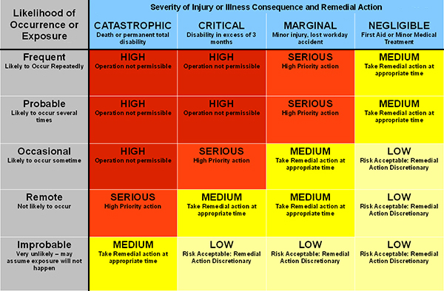
Risk assessment matrix

Slide 11
Hazard assessment
HAZARD RECOGNITION | PROBABILITY | SEVERITY
SLIPS – TRIPS – FALLS | FREQUENT
PUNCTURE WOUNDS | FREQUENT
FALLING OBJECTS | OCCASIONAL
FLYING DEBRIS | REMOTE
ELECTRICAL | PROBABLE
GAS (NATURAL/PROPANE) | PROBABLE
LACERATIONS | FREQUENT
STRAINS & SPRAINS | PROBABLE
HEAT STRESS | OCCASIONAL
INHALATION | OCCASIONAL
HAZARD RECOGNITION | PROBABILITY | SEVERITY | RISK
SLIPS – TRIPS – FALLS | FREQUENT | MARGINAL
PUNCTURE WOUNDS | FREQUENT | MARGINAL
FALLING OBJECTS | OCCASIONAL | CRITICAL
FLYING DEBRIS | REMOTE | MARGINAL
ELECTRICAL | PROBABLE | CRITICAL
GAS (NATURAL/PROPANE) | PROBABLE | CRITICAL
LACERATIONS | FREQUENT | MARGINAL
STRAINS & SPRAINS | PROBABLE | MARGINAL
HEAT STRESS | OCCASIONAL | MARGINAL
INHALATION | OCCASIONAL | CRITICAL
HAZARD RECOGNITION | PROBABILITY | SEVERITY | RISK
SLIPS – TRIPS – FALLS | FREQUENT | MARGINAL | SERIOUS
PUNCTURE WOUNDS | FREQUENT | MARGINAL | SERIOUS
FALLING OBJECTS | OCCASIONAL | CRITICAL | SERIOUS
FLYING DEBRIS | REMOTE | MARGINAL | MEDIUM
ELECTRICAL | PROBABLE | CRITICAL | HIGH
GAS (NATURAL/PROPANE) | PROBABLE | CRITICAL | HIGH
LACERATIONS | FREQUENT | MARGINAL | SERIOUS
STRAINS & SPRAINS | PROBABLE | MARGINAL | SERIOUS
HEAT STRESS | OCCASIONAL | MARGINAL | MEDIUM
INHALATION | OCCASIONAL | CRITICAL | SERIOUS

Slide 12
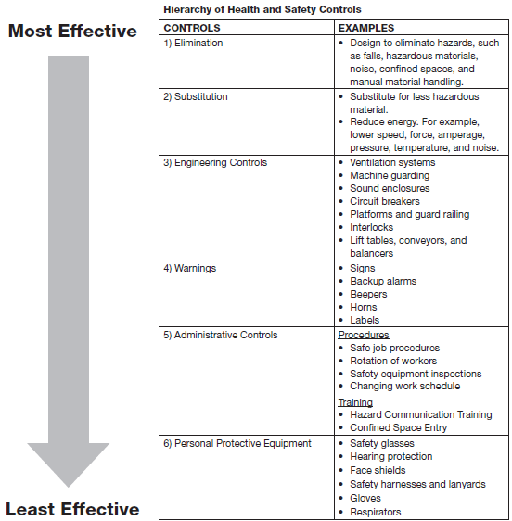
HAZARD CONTROLS

Slide 13
activity
Break into assigned groups.
Use Module 1 of the Disaster Site Worker manual.
Use the given Hazard Recognition, Assessment and Risk worksheet.
Elect a group spokes person.
Present your Hazard Recognition, Assessment, Risks & Controls.

Slide 14
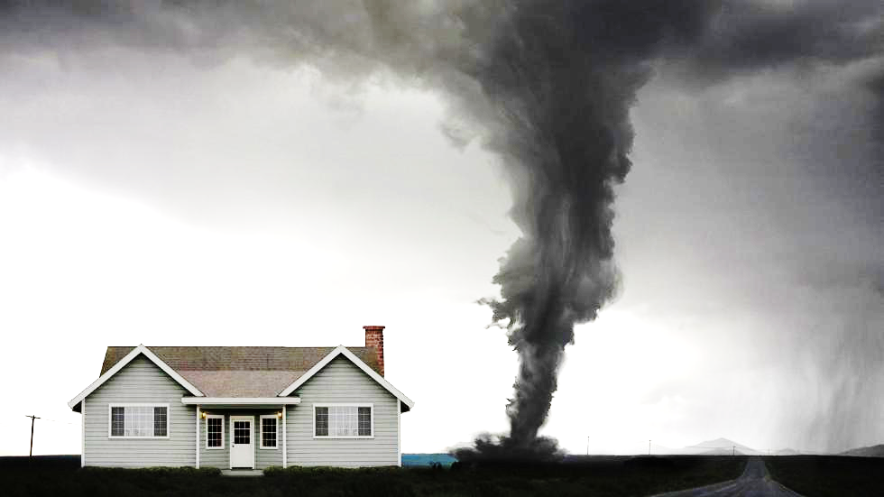
Dashboard
HEALTH HAZARDS

Slide 15
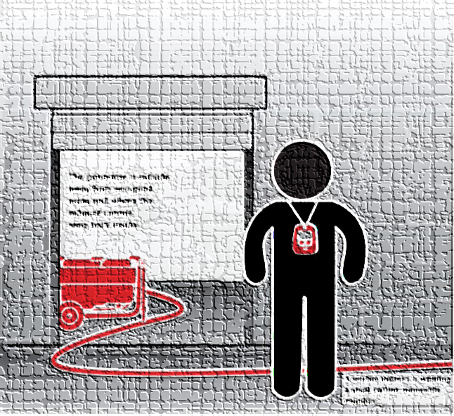
ToolBOX Talks
CPWR maintains a large collection of toolbox talks and has worked closely with NIOSH to ensure that this series incorporates effective elements like case studies, discussion questions, and site-specific actions. The Spanish versions were initially developed with the support of the American Society of Safety Engineers (ASSE).
https://www.cpwr.com/publications/toolbox-talks

